Slide 1
How to Build Your True Net Worth
Kyle Beveridge

Slide 2
All the information provided in this presentation pertaining to investing, options, stocks, and securities is educational information and not investment advice. Specific securities are mentioned for informational purposes only. Nothing in this presentation, including references to specific securities, constitutes a recommendation, solicitation, or an invitation to buy, sell, or hold a security; buy or sell options; or engage in a particular investment strategy. Any examples shared in this presentation, including hypotheticals, are not guarantees of a return on investments. Information within this presentation may contain “forward-looking statements” within the meaning of Section 27A of the Securities Act of 1933 and Section 21B of the Securities Exchange Act of 1934. Any statements that express or involve discussions with respect to predictions, goals, expectations, beliefs, plans, projections, objectives, assumptions, or future events or performance are not statements of historical fact and may be “forward-looking statements.” Forward-looking statements are based on assumptions, expectations involving various risks and uncertainties, estimates, and projections at the time the statements are made that involve a number of risks and uncertainties, which could cause actual results or events to differ materially from those presently anticipated. The person observing this presentation should not place undue reliance on forward-looking statements contained in this presentation. All investments involve risk, and the past performance of a security, industry, sector, market, financial product, or investment does not guarantee future results or returns. Investors are fully responsible for any investment decisions they make. Such decisions should be based solely on an evaluation of the investor’s financial circumstances, investment objectives, risk tolerance, and liquidity needs. Kyle Beveridge is a licensed financial advisor with both Invicta Capital LLC and Invicta Advisors LLC. ESB W&I (Wealth and Investments) is not affiliated with Invicta Capital LLC or Invicta Advisors LLC. Kyle Beveridge is not liable for any damages, either directly or indirectly, arising from the use and/or misuse of this presentation. This presentation nor Kyle Beveridge makes any guarantees that the investment financial guidelines outlined in this presentation will be profitable for the individual investor, and they are not liable for any potential losses related to these investment strategies. Even though every precaution has been taken in the preparation of this presentation, the presenter does not assume any liability for errors and/or omissions. This presentation is presented “as is,” without warranty or guarantee of any kind, either express or implied. You, as the observer and participant, agree to release and hold harmless Kyle Beveridge, his members, employees, agents, ghostwriter, affiliates, subsidiaries, successors, and assigns (collectively “agents”) from and against any and all claims, liabilities, losses, causes of actions, costs, lost profits, lost opportunities, indirect, special, incidental, consequential, punitive, or any expense and other damages whatsoever (including, without limitation, court costs and attorney’s fees) (“losses”) asserted against, resulting from, imposed upon, or incurred by any of the agents as a result of, or arising out of your use of the presentation.

Slide 4
The Lord detests dishonest scales, but accurate weights find favor with him.
—Proverbs 11:1 NIV

Slide 5
Building Wealth Is Not Mysterious
Like Jesus all man and all God—who walked through a door into a room yet ate fish a few day earlier.
Why did Joseph and Mary have to escape into Egypt to avoid Herod when God could have wiped out Herod with a host of angels or just have him die of some disease?

Slide 6
Is It Okay to Acquire Wealth?
Why didn’t God keep Job poor?
Why did God bring wise men to Jesus bearing gifts that in today’s standards value over $4 million?*
* https://askinglot.com/how-much-were-the-wise-mens-gifts-worth

Slide 7
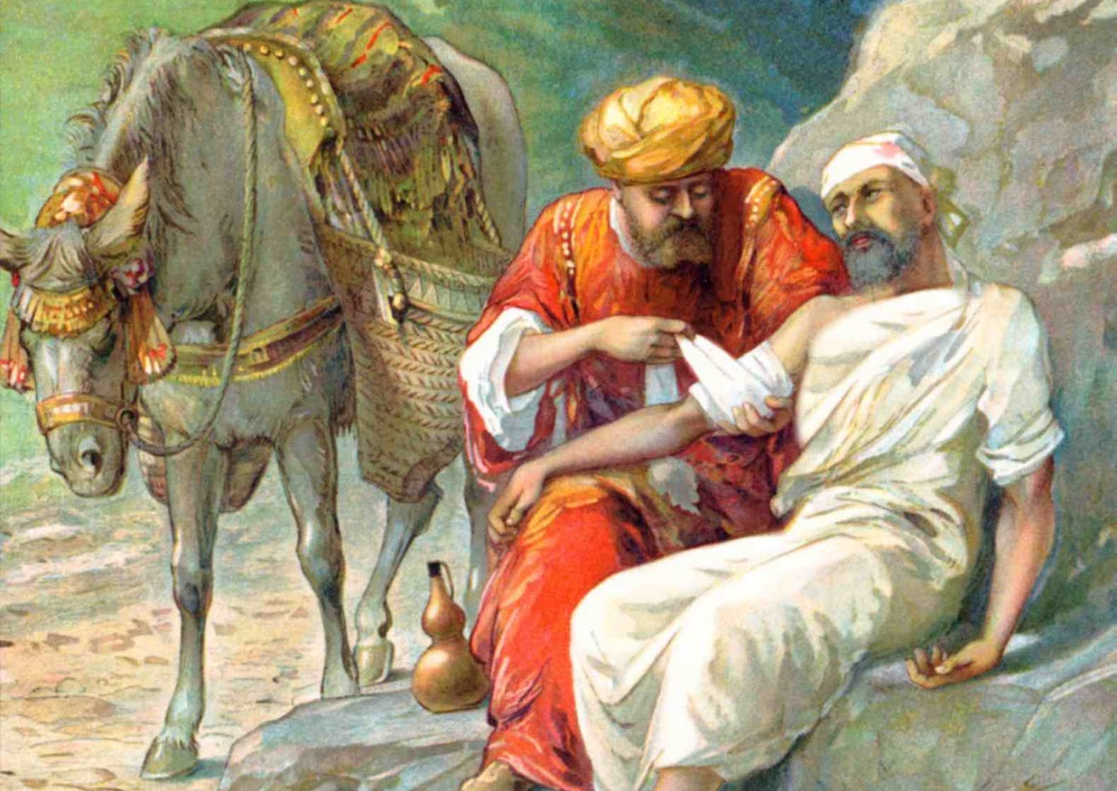
Become a critical thinker and realize your true potential to accumulate monies and to be content so that you could possibly some day be the Good Samaritan.

Slide 8
“History convincingly demonstrates that stocks have been and will remain the best investment for all those seeking long-term gains.”
—Dr. Jeremy Siegel

Slide 9
Demystifying the Myths
Too risky
Investing is only for rich folks
Invest in gold because it will always hold its value
Investing is a game of chance

Slide 10
Hypothetical Mutual Fund Growth of $50 per Month

Slide 15
Why Not Rental Properties?

Slide 16
“I have never seen a stock equity that needed a new roof!”
—Economist Ben Stein

Slide 17
Why Not Both?

Slide 18
Owner versus a Loaner

Slide 19
Good Debt
vs.
Bad Debt

Slide 21
Tools

Slide 22
We insure all the stuff but not the people who make the stuff function.

Slide 23
How Much and What Kind?
Why Not Both: Whole Life and Term

Slide 24
Expect the Unexpected

Slide 26
Questions

